Slide 1

A Survey Of Deep Learning based Object detection
Chetan Kulkarni

Slide 2
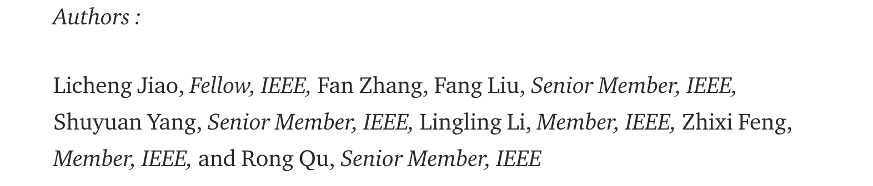

Slide 3

Datasets

Slide 4
Pascal VOC
20 object categories as 4 main branches-vehicles, animals, household objects, and people
spread over 11,000 images.
Over 27,000 object instance bounding boxes are labeled
7,000 have detailed segmentations.

Slide 5
COCO DATASET
91 common object categories
82 of them having more than 5,000 labeled instances.
These categories cover the 20 categories in the PASCAL VOC dataset.
2,500,000 labeled instances in 328,000 images

Slide 6
OTHER DATASETS
Open Images
ImageNet

Slide 7
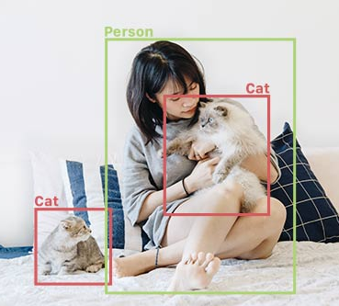
Object Detection
Identify and locate objects in an image or video
Source : https://www.fritz.ai/object-detection/#:~:text=Object%20detection%20is%20a%20computer,all%20while%20accurately%20labeling%20them.

Slide 8
Kinds of Object Detection
Two-Stage Detector
One Stage Detector

Slide 9
Examples of Two Stage detectors
R-CNN
Fast R-CNN
Faster R-CNN
Masked R-CNN

Slide 10
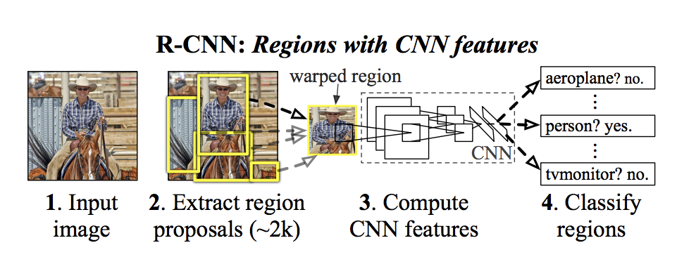
R-CNN
Generates category-independent region proposals.
Extract a fixed-length feature vector from each region proposal.
Set of class-specific linear SVMs to classify the objects in one image.
Bounding-box regressor for precisely bounding-box prediction.

Slide 11
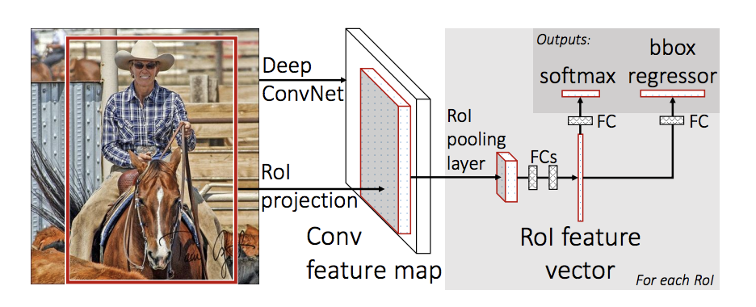
Fast R-CNN
Fast R-CNN produces Region of Interest(RoI) using the Max Pooling layer
the SVM layer is replaced with SVD which fastens the process even further.

Slide 12
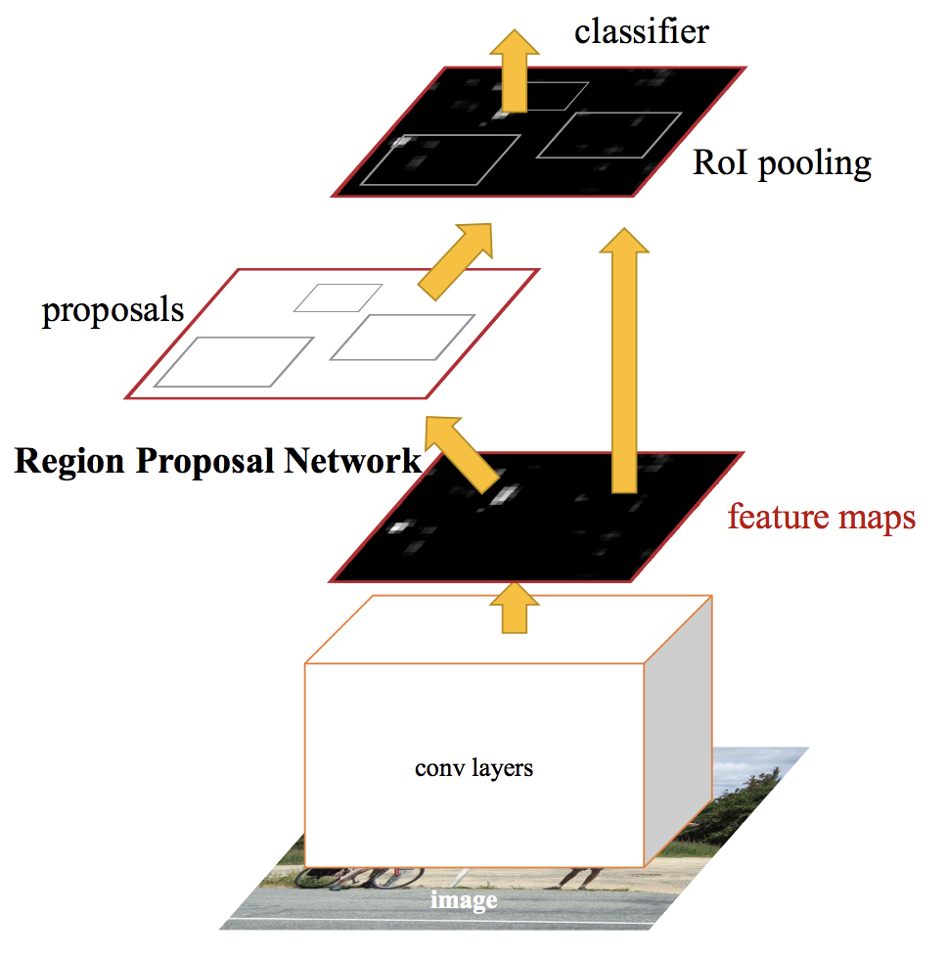
Faster R-CNN:
The Region interested in Fast R-CNN was based on a selective search using Max Pooling layers, this was slow.
So in Faster R-CNN replaces the region selection method with a novel RPN

Slide 13
Mask R-CNN
The faster R-CNN performs well, but it has an Instance Segmentation Problem.
It generates proposals about the regions where there might be an object based on the input image.
It predicts the class of the object, refines the bounding box, and generates a mask in the pixel level of the object based on the first stage proposal.

Slide 14
One-Stage Detectors
Yolo
Yolo v2
Yolo V3
SSD
DSSD

Slide 15
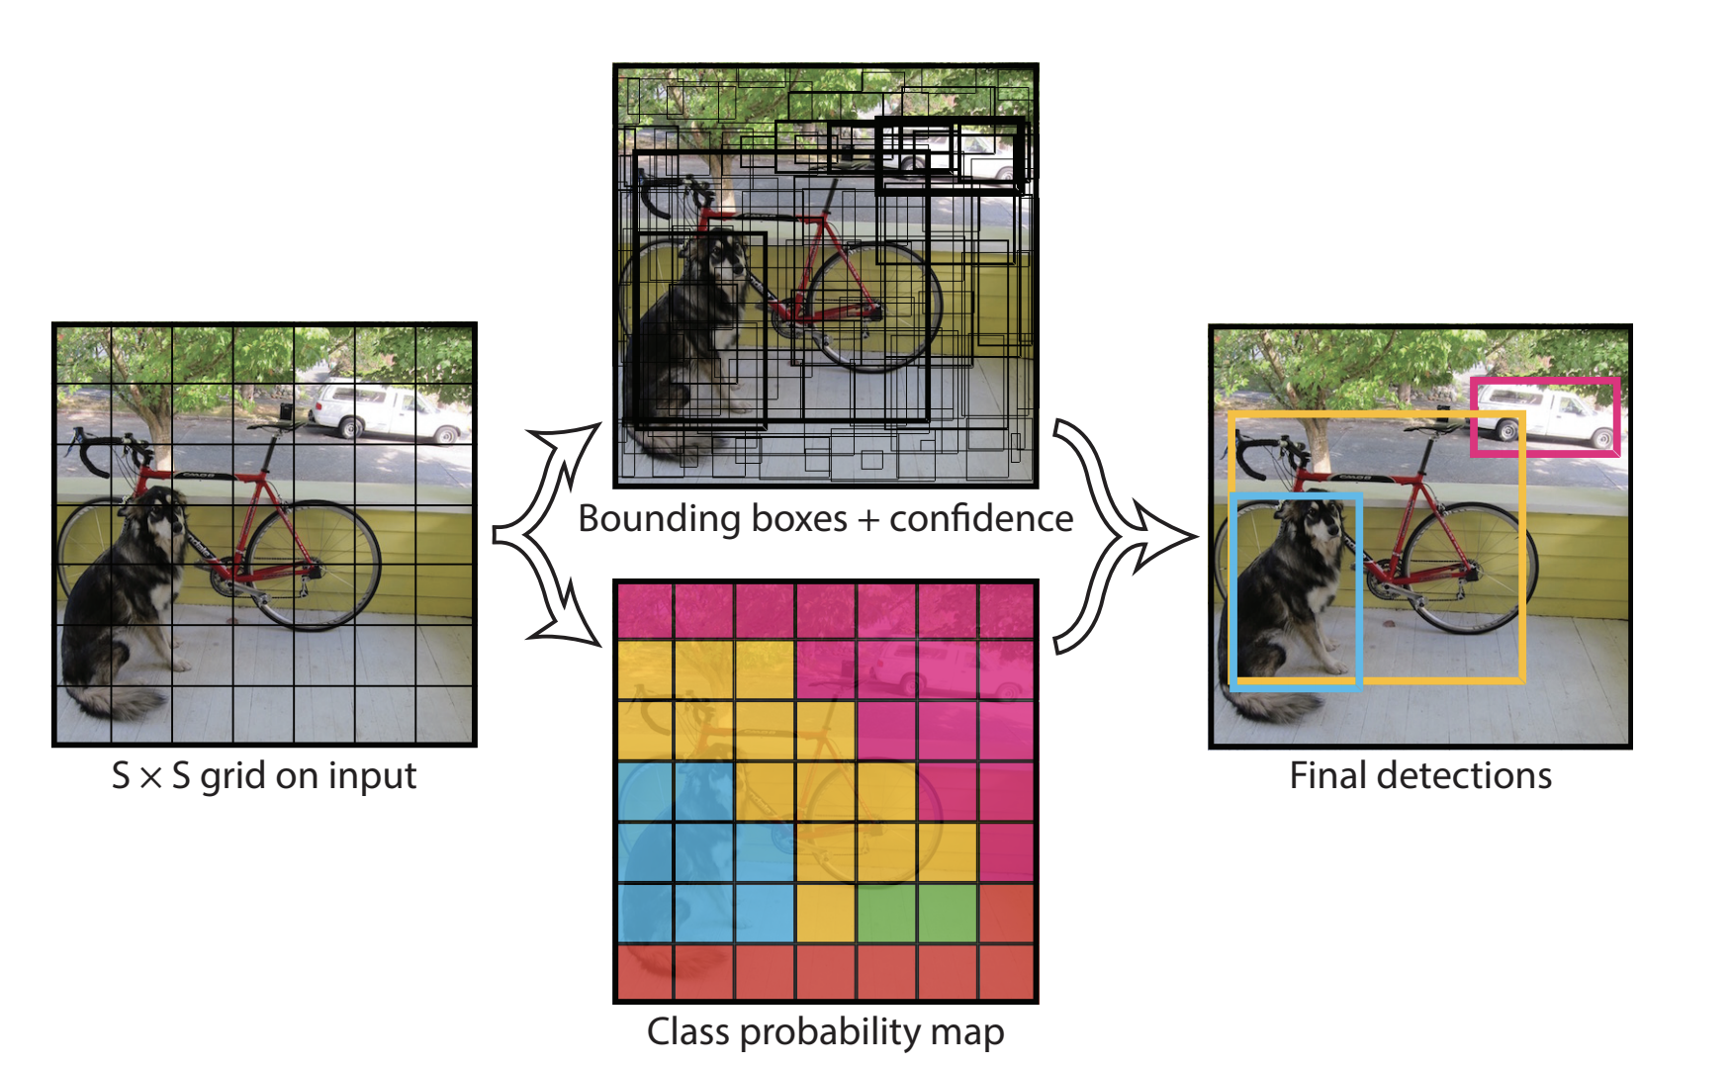
YOLO
There is no region creation and then again processing on top of that
Rather there is one convolution network that creates boxes and class predictions for each box.

Slide 16
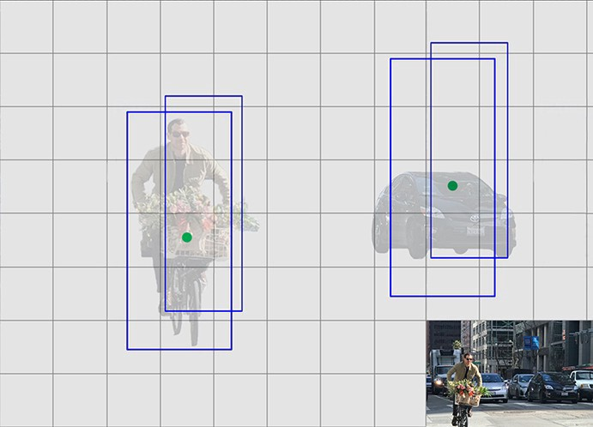
YOLO V2
Following were introduced
Batch Normalization
High-Resolution Classifier
Use Anchor Boxes For Bounding Boxes

Slide 17
YOLO V3
This has the following updated changes:
Multi-Label Classification
Use of Feature Maps to predict Bounding Boxes
Uses Darknet as final Feature Extractor

Slide 18
SINGLE SHOT DETECTOR (SSD)
Single Shot: this means that the tasks of object localization and classification are done in a single forward pass of the network
01
MultiBox: this is the name of a technique for bounding box regression
02
Detector: The network is an object detector that also classifies those detected objects
03

Slide 19
Deconvolutional Single Shot Detector (DSSD)
Gradual deconvolution to enlarge the feature maps
Feature Combination from convolution path and deconvolution path

Slide 20
Applications
Pedestrian Detection
Face Detection
Generic Object Detection
Theft Detection

Slide 21
Conclusion
There are unimaginable number of objects and building a framework capable to detect them is going to be never ending task.
But more improved targeted application is already possible and will be more robust in coming days

